Slide 1
Multimedia and Communications II CS2033a/b Lecture 8 Dropdown Menus Library Items
Templates Vivi Tryphonopoulos

Slide 2
Library Items and Templates
Now build a website using: Library Items, and Templates
Using CSS Styles
Control through:
Box model: Layout sections → Div Ids (#header,#navbar, #content)
CSS Styles:Classes, Tags, Compounds Appearance and behaviour of elements (text, images, lists,links etc)
Next learn:
Library Items: control _______ information
Templates: control _________ for maintaining consistency across the website
Will help with maintaining a website Updating multiple pages quickly!
Notes:
16px may look great on a desktop monitor, but on a mobile device 16px is huge
If we use 1em , telling device to set font to 100% of its default font size which is one size on the desktop and another size on a mobile device

Slide 3
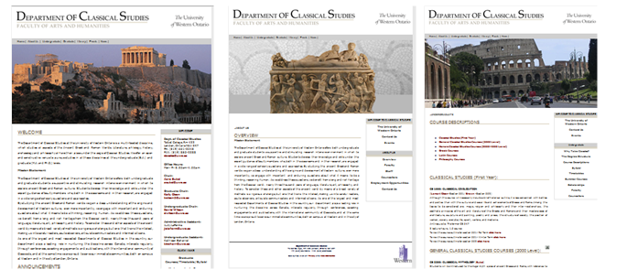
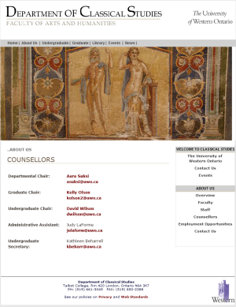
Library Items
What are Library Items?
Reusable information of HTML code → paragraphs, links, tables, images navigation bars etc.
Think: What kind of information may change in a website?
Copyright information, Address information
Menu links: add more menu items
Contact Information for different groups
Announcements box
Used for individual page elements that appear frequently BUT not on every page within a website
Information that will:
Change later
AND will appear frequently throughout the website
Notes:
16px may look great on a desktop monitor, but on a mobile device 16px is huge
If we use 1em , telling device to set font to 100% of its default font size which is one size on the desktop and another size on a mobile device

Slide 4
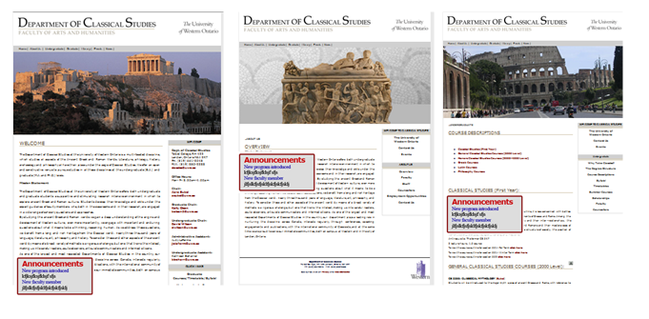
Library Items
Case Scenario 1:
Reusable information – Announcements
Step 1: Define Announcements as a Library item
Step 2: Then insert the library item code into every page BUT may not appear on every page within a website
Same reusable info can be on the same webpage several times
Same reusable information can be on the same webpage in different spots
Same reusable info on different webpages in different spots.
When you create a Library item
Extension .lbi ie announcements.lbi
Automatically creates a folder called “Library” at root level
Stores library item in the folder
Notes:
16px may look great on a desktop monitor, but on a mobile device 16px is huge
If we use 1em , telling device to set font to 100% of its default font size which is one size on the desktop and another size on a mobile device

Slide 5
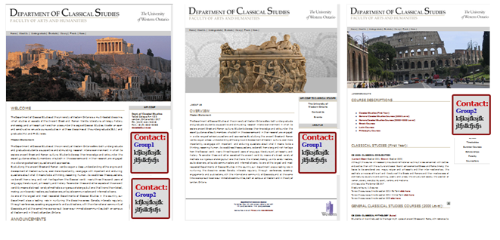
Library Items
Case Scenario 2:
Reusable information – Contact Group 1 and Contact Group2
Define Group1 as a Library item and Contact Group2 as a Library item
Notes:
16px may look great on a desktop monitor, but on a mobile device 16px is huge
If we use 1em , telling device to set font to 100% of its default font size which is one size on the desktop and another size on a mobile device

Slide 6
Library Items
Case Scenario 3:
Reusable information – Footer information added Different info for groups within dept Define Footer1 as a Library item and Footer2 as a Library item
Footer1
Footer1
Footer2
Footer2
Notes:
16px may look great on a desktop monitor, but on a mobile device 16px is huge
If we use 1em , telling device to set font to 100% of its default font size which is one size on the desktop and another size on a mobile device

Slide 7
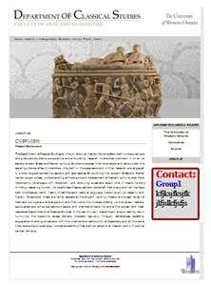
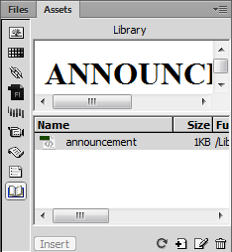
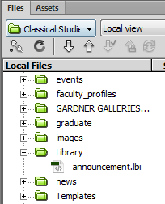
Library Items
Advantages of Library Items:
Consistency of look and appearance of reusable/repetitive info
Ability to make global changes to those items via the Library item
Immediate update in webpages where Library item appears
Process:
Highlight the element in the webpage that is going to be considered the repetitive information
Create the Library item: Modify> Library > Add Object to Library
Result:
Give name contactgroup1.lbi (thru Assets panel)
Stores the snippet of code in folder Library (gets created automatically if doesn’t exist at root level)
Turns it into a yellow highlight (default) which restricts you from editing it from the Document window.
Modify info from Assets panel, File panel, Property panel
Actual code is stored in this file here
Notes:
16px may look great on a desktop monitor, but on a mobile device 16px is huge
If we use 1em , telling device to set font to 100% of its default font size which is one size on the desktop and another size on a mobile device

Slide 8
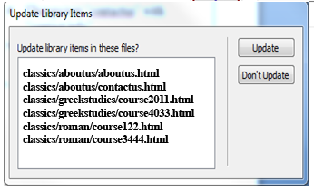
Library Items
Process – continued
Insert library item into different spots into your code via Assets “Insert” button.
Modify info “announcements.lbi” and watch it update every instance throughout website.
Notes:
16px may look great on a desktop monitor, but on a mobile device 16px is huge
If we use 1em , telling device to set font to 100% of its default font size which is one size on the desktop and another size on a mobile device

Slide 9
Templates
What are Templates?
A template is a common structure that most of your web pages follow.
All webpages based on this template, follow the same structure, design, appearance, and styles.
→ only thing different is the content in certain areas. What’s common in all webpages?
Layout: header, navigation bar(menu), footer , sidebar
CSS Styles: uses the same css stylesheets to keep consistency amongst tags, links, classes... So the template uses the same stylesheet
Notes:
16px may look great on a desktop monitor, but on a mobile device 16px is huge
If we use 1em , telling device to set font to 100% of its default font size which is one size on the desktop and another size on a mobile device

Slide 10
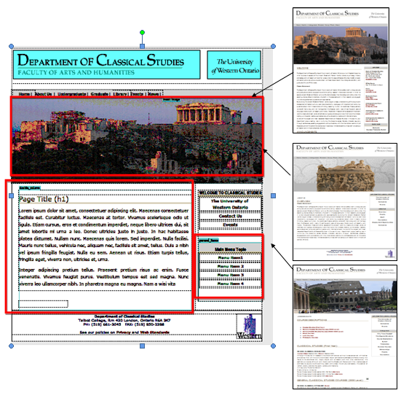
Templates
Webpages based on template (.html)
How do templates work?
Start off with an .html file.
Design the layout, the styles etc.
Define regions: editable vs non-editable
Save it as a template: File > Save as Template (give it a name) i.e master.dwt, main_template.dwt, classics_master.dwt
Results:
Saves template as .dwt
Creates a folder called Templates at root level and stores all templates that you create.
Create new pages based on template
File > New and click on Templates tab to select the template you want to use
Save webpages as .html
Template (.dwt)
Every webpage is tied to the master template
Make a change to the master template.. Automatic update to all webpages tied to it
Notes:
16px may look great on a desktop monitor, but on a mobile device 16px is huge
If we use 1em , telling device to set font to 100% of its default font size which is one size on the desktop and another size on a mobile device

Slide 11
Templates
Parts of a Template:
Non-Editable Regions
Areas of a webpage that will stay the same on every webpage in a website
ie Banner, Menu, Footer.
Those webpages tied to a template means you cannot edit these regions because they are locked regions
→Restricted from change
Editable Regions
Identify areas of a webpage that will be different on every webpage
Content section
Top image
Sidebar (or part of it)
Those webpages tied to a template means you can only modify the editable regions
Prevents maintainers from changing things accidentally to the menu system, footer info etc. → can only change the content
When starting a new site:
Start off with an .html file.
Design the layout, the styles etc.
Define regions: editable regions (default is that a region is considered to be locked)
Save it as a template: File > Save as Template
Note: you can modify a template to change regions BUT DON’T DO IT IF WEBPAGES ARE ALREADY CREATED! -Total Mess!!
Notes:
16px may look great on a desktop monitor, but on a mobile device 16px is huge
If we use 1em , telling device to set font to 100% of its default font size which is one size on the desktop and another size on a mobile device

Slide 12
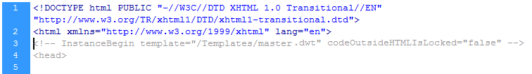
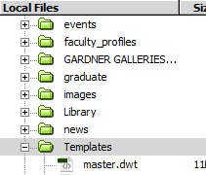
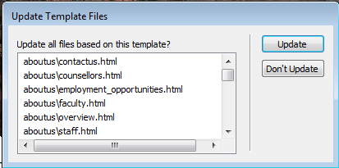
Templates
Modifying a Template:
From Templates folder → Double-click on template and modify the template → Modify the non-editable regions → Since this is the same info on every webpage that is common
You modify the non-editable Regions
Banner
Menu (add another link)
Footer information
Sidebar information
Notes:
16px may look great on a desktop monitor, but on a mobile device 16px is huge
If we use 1em , telling device to set font to 100% of its default font size which is one size on the desktop and another size on a mobile device

Slide 13
Templates vs Library Items
Templates
Extension .dwt
Stored in Templates folder
A common structure that your web pages follow.
Same structure, design, appearance, and styles.
Choice to designate editable regions so that maintainer can change content
You can have two different templates associated with a website.. But tricky!
Library Items
Extension .lib
Stored in Library Folder
Reusable/repetitive info (snippets of code)
Reusable information can be placed on different webpages and in different spots
A website can be made up of both Templates and Library items
Assign Library items in the “Editable Regions”
Notes:
16px may look great on a desktop monitor, but on a mobile device 16px is huge
If we use 1em , telling device to set font to 100% of its default font size which is one size on the desktop and another size on a mobile device

Slide 14
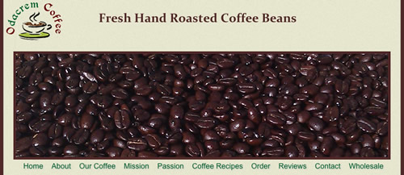
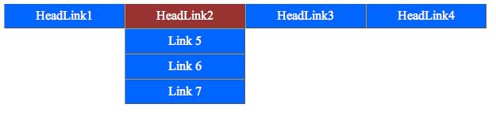
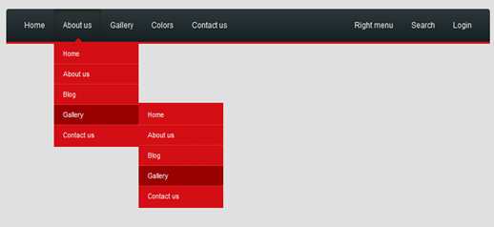
Creating Menus strictly with CSS Styles
Menu (Navigation Bar)
Every website has a menu bar
Allows movement from one webpage to another
Menu bar choices:
One level
Two levels
Three levels (avoid)
Notes:
16px may look great on a desktop monitor, but on a mobile device 16px is huge
If we use 1em , telling device to set font to 100% of its default font size which is one size on the desktop and another size on a mobile device

Slide 15
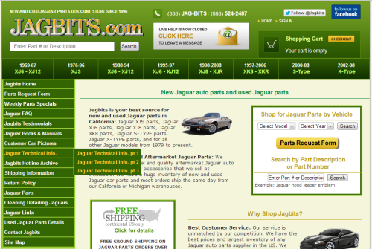
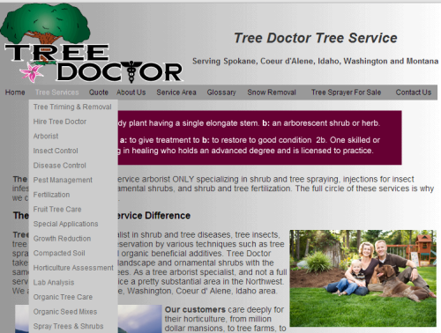
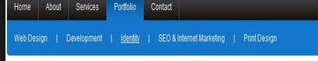
Creating Menus strictly with CSS Styles
Vertical Dropdown
Vertical vs Horizontal Dropdowns
The word “dropdown” refers to a two or more tiered navigation system
Best practice never to go more than 2 levels
Vertical dropdown: vertical list of options that each contain a submenu
Horizontal dropdown: horizontal list of options that each contain submenu or a vertical submenu
Horizontal Dropdown
Notes:
16px may look great on a desktop monitor, but on a mobile device 16px is huge
If we use 1em , telling device to set font to 100% of its default font size which is one size on the desktop and another size on a mobile device

Slide 16
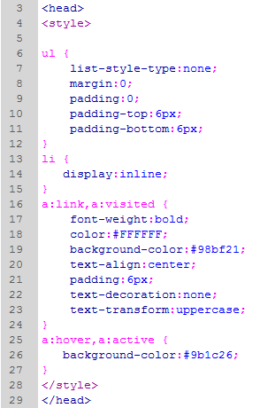


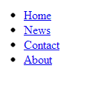
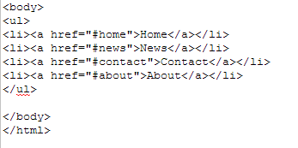
Creating Menus strictly with CSS Styles
Your basic 1-Tiered Horizontal menu
Remove the bullets
Removes browser defaults
Force the <li> elements onto one line – remove the breakline
Menus are based on an unordered list
Behaviour of links: visited & unvisited
When it hovers change bg to red - no underlining because a:link has text-decoration:none
Notes:
16px may look great on a desktop monitor, but on a mobile device 16px is huge
If we use 1em , telling device to set font to 100% of its default font size which is one size on the desktop and another size on a mobile device

Slide 17
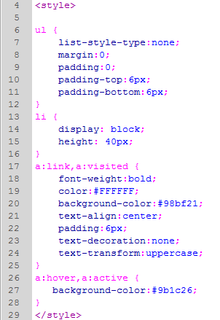
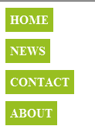

Creating Menus strictly with CSS Styles
Your basic 1-Tiered Vertical menu
ONLY THING CHANGED:
From last slide changed it to
Display:block;
Height:40px
Block puts it on a line of its own– forces a break
Menus are based on an unordered list
Notes:
16px may look great on a desktop monitor, but on a mobile device 16px is huge
If we use 1em , telling device to set font to 100% of its default font size which is one size on the desktop and another size on a mobile device

Slide 18
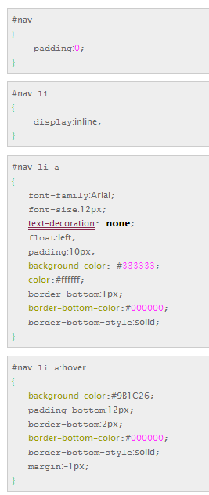


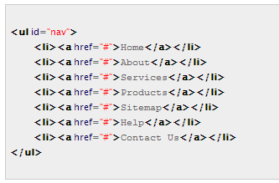
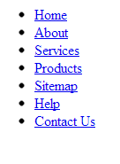
Creating Menus strictly with CSS Styles
Your basic 1-Tiered Horizontal menu
Force the <li> elements on one line – remove the breakline
Behaviour of <li> as a visited and unvisited link “a href=”
Menus are based on an unordered list
But in a div
No underlining
Block elements slide next to each other
Notes:
16px may look great on a desktop monitor, but on a mobile device 16px is huge
If we use 1em , telling device to set font to 100% of its default font size which is one size on the desktop and another size on a mobile device

Slide 19
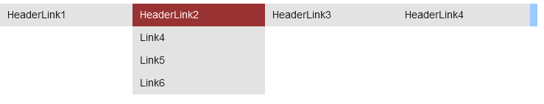
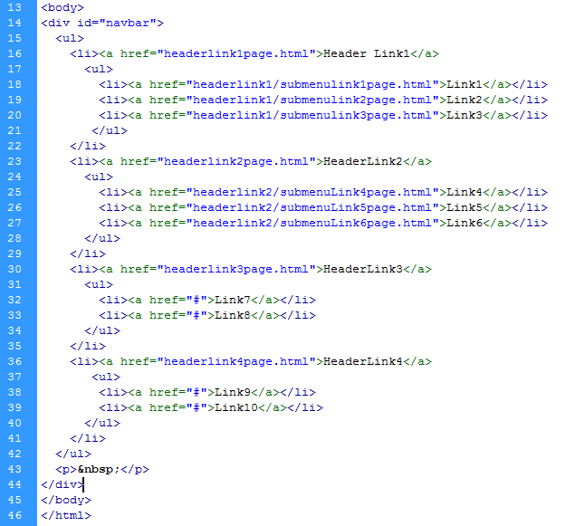
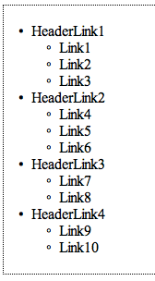
Creating Menus strictly with CSS Styles
Creating a 2-tiered Horizontal dropdownmenu
Starting point is the unordered list
Will be learning how to do this in the lab!
Definitely more complicated!
Notes:
16px may look great on a desktop monitor, but on a mobile device 16px is huge
If we use 1em , telling device to set font to 100% of its default font size which is one size on the desktop and another size on a mobile device

Slide 20
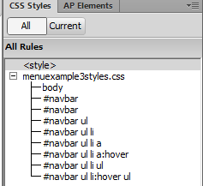
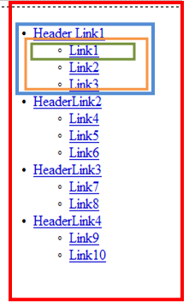
Creating Menus strictly with CSS Styles
Creating a 2-tiered Horizontal dropdownmenu
Starting point is the unordered list
Controls dropdown submenu
Notes:
16px may look great on a desktop monitor, but on a mobile device 16px is huge
If we use 1em , telling device to set font to 100% of its default font size which is one size on the desktop and another size on a mobile device

Slide 21
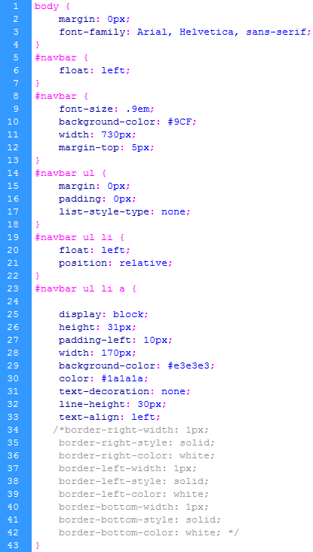
Creating a 2-tiered Horizontal dropdownmenu
Notes:
16px may look great on a desktop monitor, but on a mobile device 16px is huge
If we use 1em , telling device to set font to 100% of its default font size which is one size on the desktop and another size on a mobile device

Slide 22
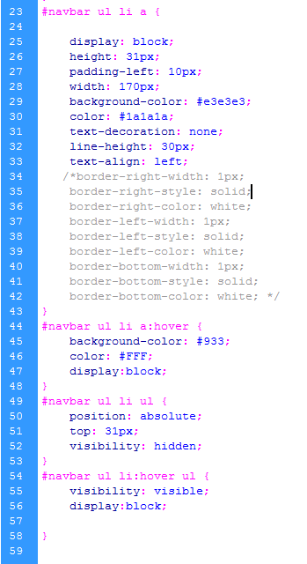
Creating a 2-tiered Horizontal dropdownmenu
Notes:
16px may look great on a desktop monitor, but on a mobile device 16px is huge
If we use 1em , telling device to set font to 100% of its default font size which is one size on the desktop and another size on a mobile device

Slide 23
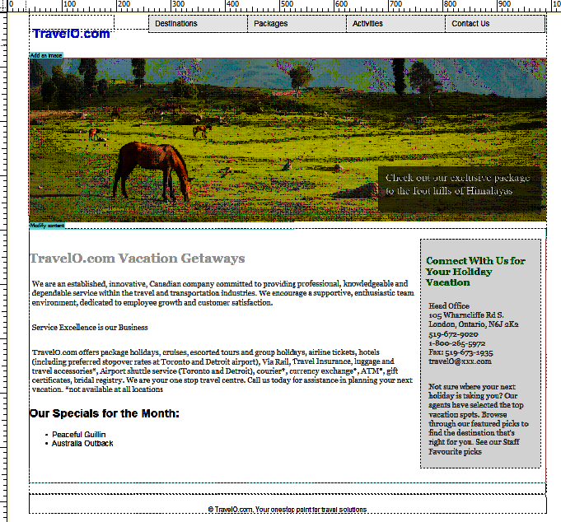
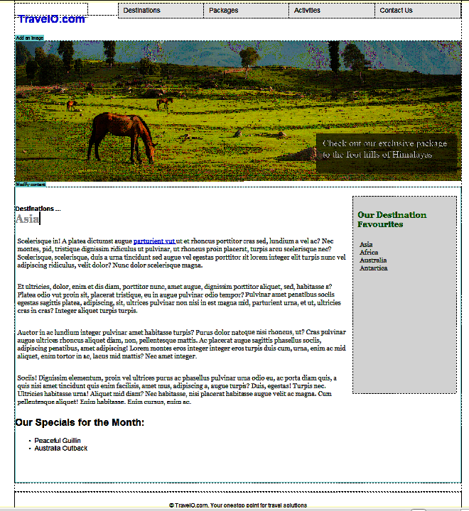
Dropdown Menu Etiquette
Need to know what page you are on
How?
Page title heading in content area
Indication of which top menu option it came from
Webpage heading itself
→ 2 lines needed – change the contrast, the look
2nd line should be predominant

Slide 24
Dropdown Menu Etiquette
For Search Engine Optimization
Don’t forget the Property Title
Homepage:
TravelO – Vacation Getaways at Great Prices
Other webpages using a dropdown menu
TravelO – Destinations- Asia
TravelO – Destinations – Africa
TravelO – Packages – Carribean Cruises
TravelO – Packages – Mediterranean Cruises

Slide 25
This Week in Lab
Creating Menus – Horizontal dropdown
Libraries
Templates

